Slide 1
MAJOR PROJECT PRESENTATION ON Personalized Medicine Recommendation System

Slide 2
OUTLINES
S.NO. | CONTENTS | PAGE NO.
1 | PROBLEM STATEMENT | 3
2 | INTRODUCTION | 4
3 | TECHNOLOGIES USED | 5
4 | NECESSARY DIAGRAMS | 6
5 | FEATURES | 7
6 | CHALLENGES | 8
7 | LIMITATIONS | 9
8 | SCREENSHOTS | 10-16
9 | CONCLUSION | 17
10 | FUTURE ENHANCEMENT | 18
11 | REFERENCES | 19

Slide 3
PROBLEM STATEMENT
Many individuals face difficulty in identifying potential health issues based on early symptoms, leading to delayed diagnosis and treatment. There is a need for a system that can assist users in predicting diseases based on symptoms and provide relevant health recommendations to promote early awareness and action.

Slide 4
INTRODUCTION
Early diagnosis of diseases plays a crucial role in effective treatment and better health outcomes. However, many people struggle to understand the severity of their symptoms or delay seeking medical advice. This project aims to develop a user-friendly web-based system that predicts diseases based on user-inputted symptoms and provides essential health recommendations. By leveraging machine learning and a responsive interface, the system promotes timely awareness and proactive health management.

Slide 5
TECHNOLOGIES USED
Frontend: HTML5, CSS3, JavaScript.
Backend: Flask
The technology stack includes Python for the backend, machine learning algorithms, and modern web technologies for the frontend.

Slide 6
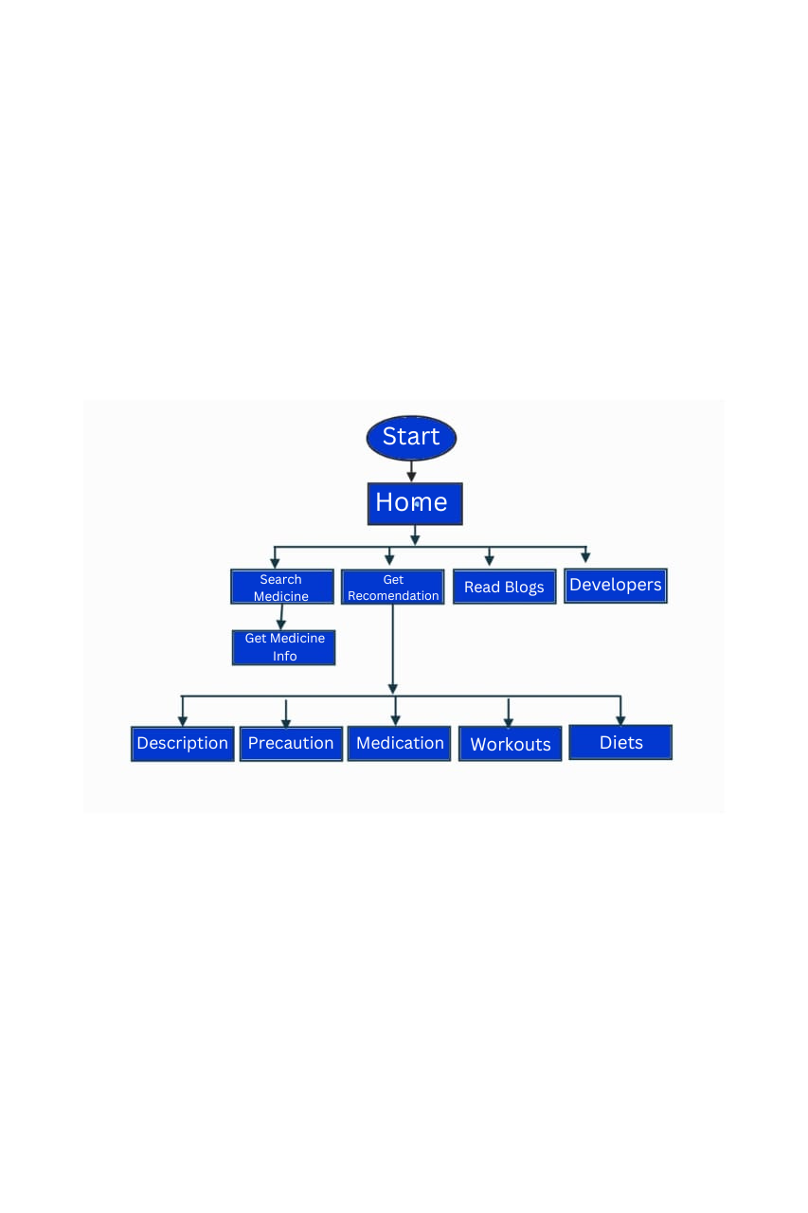
NECESSARY DIAGRAMS
Flowchart

Slide 7
FEATURES
Symptom-based disease prediction through manual input
Voice input functionality using speech recognition
Provides detailed description of the predicted disease
Suggests appropriate medications for the condition
Offers precautionary measures to manage the disease
Recommends suitable diet plans based on the prediction
Suggests relevant workout routines for better health

Slide 8
CHALLENGES
Data Privacy:- Ensuring data privacy and security.
Data Variations:- Handling complex medical data variations.
Integration:- Integrating multiple medical databases.
Overcoming technical challenges is crucial for the system's success.

Slide 9
LIMITATIONS
Dependence on Data Quality: System accuracy relies on high-quality multilingual and ISL datasets.
Limited Emotion Recognition: Lacks deep emotion or tone analysis in speech-to-speech interactions.
Scalability Constraints: Current implementation optimized for small-to-mid scale user loads.
Hardware Requirements: Performance will degrade on low-end devices

Slide 10
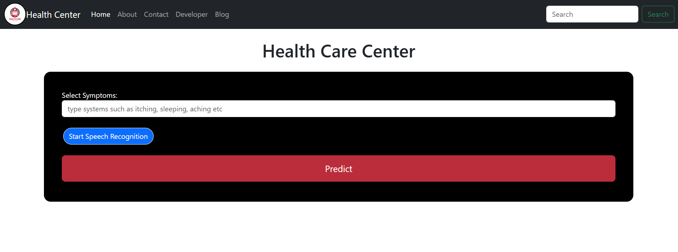
SCREENSHOTS
Home Page

Slide 11
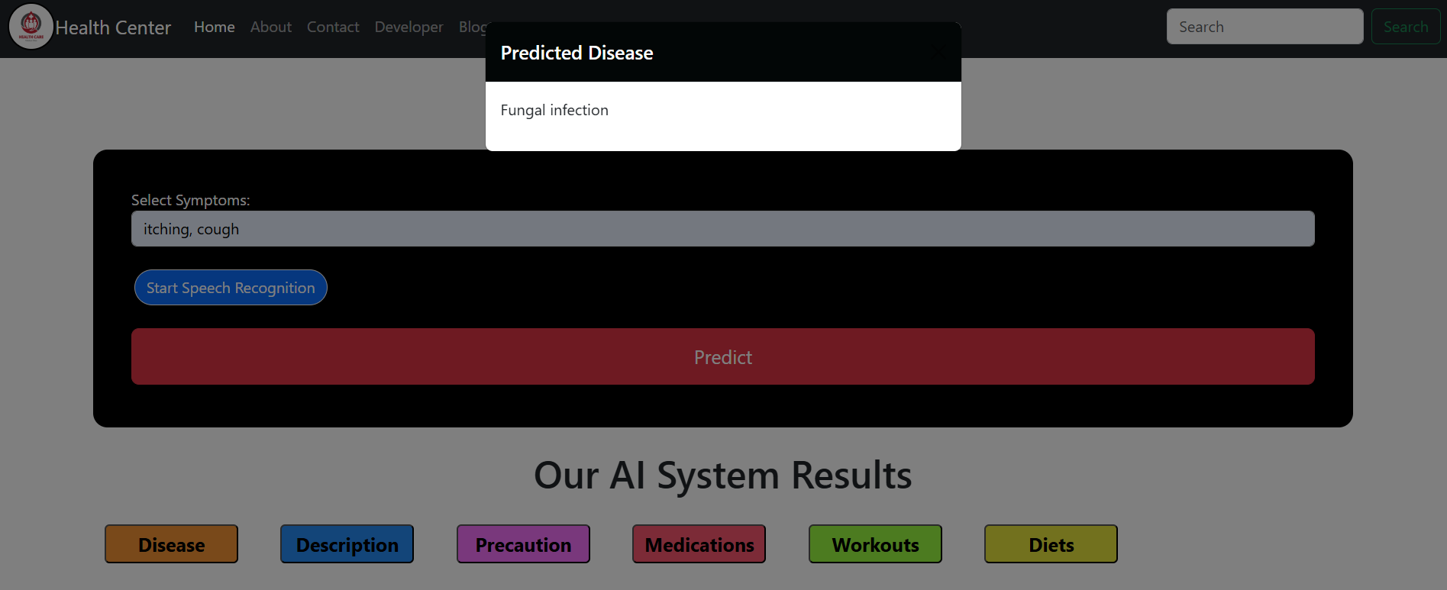
Predicted Disease

Slide 12
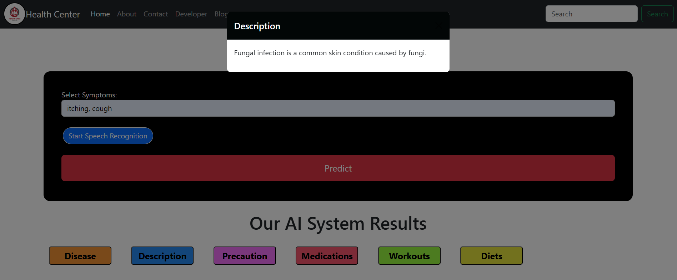
Description

Slide 13
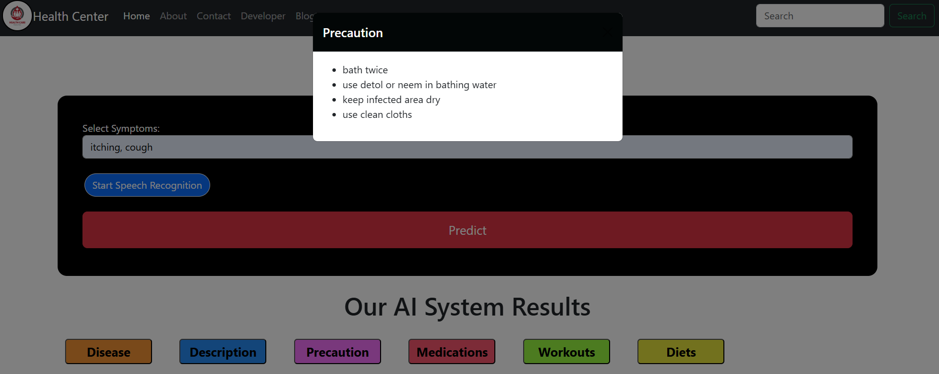
Precaution

Slide 14
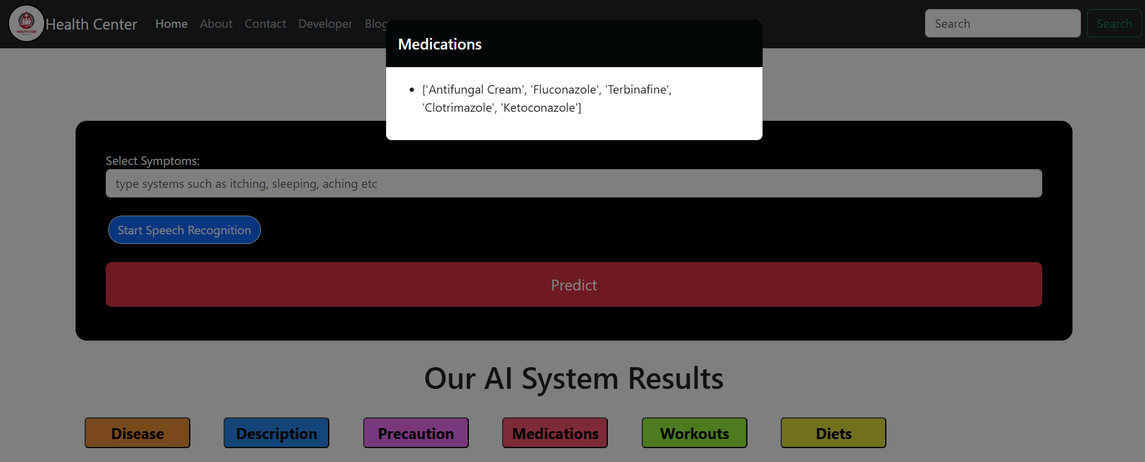
Medications

Slide 15
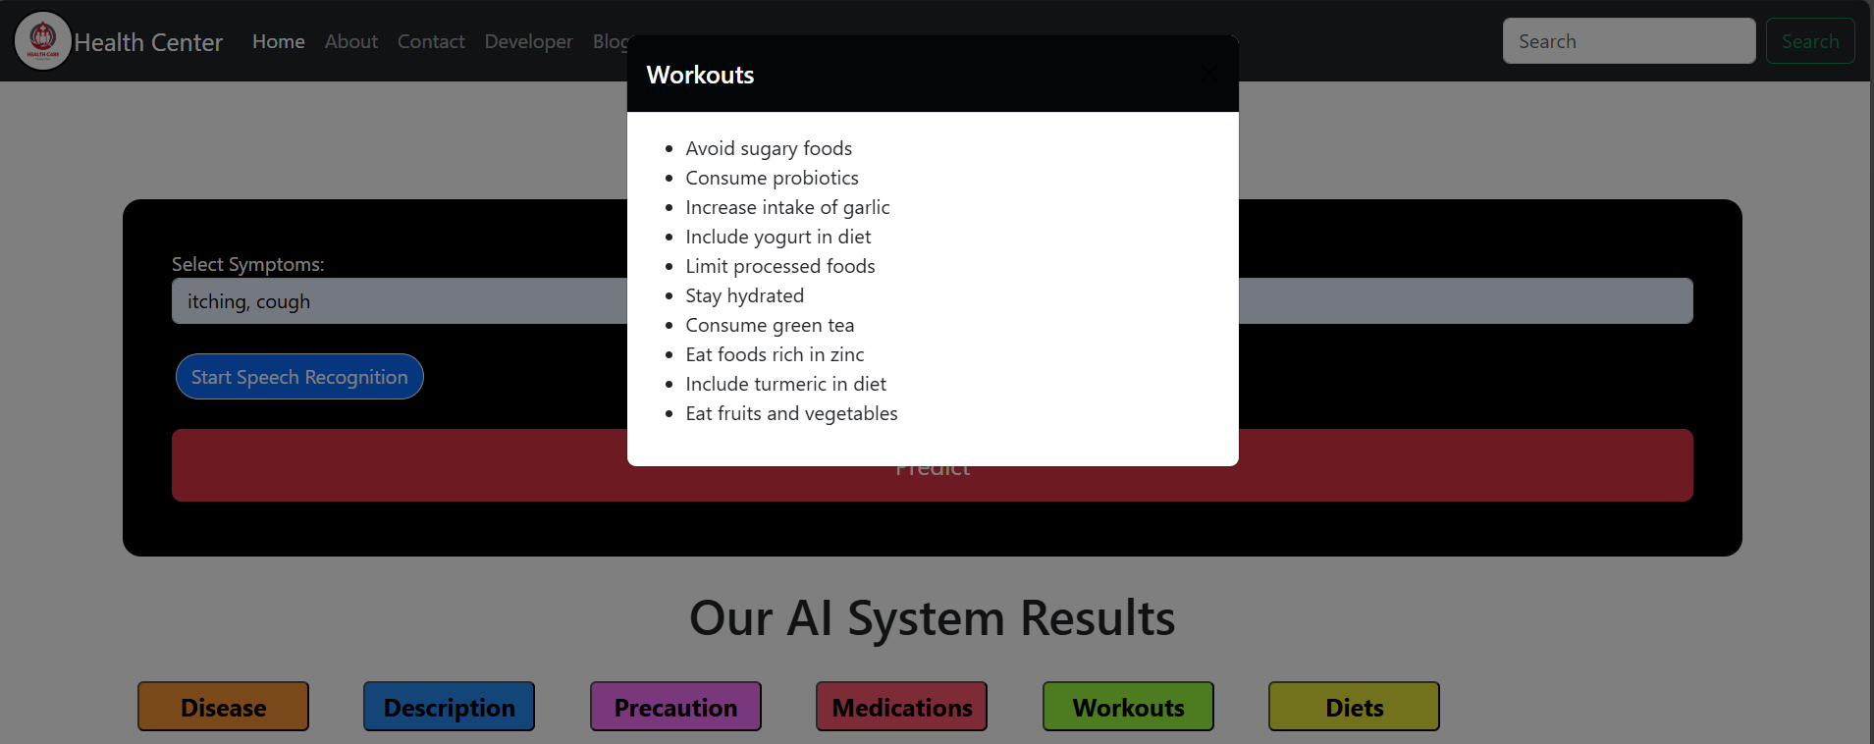
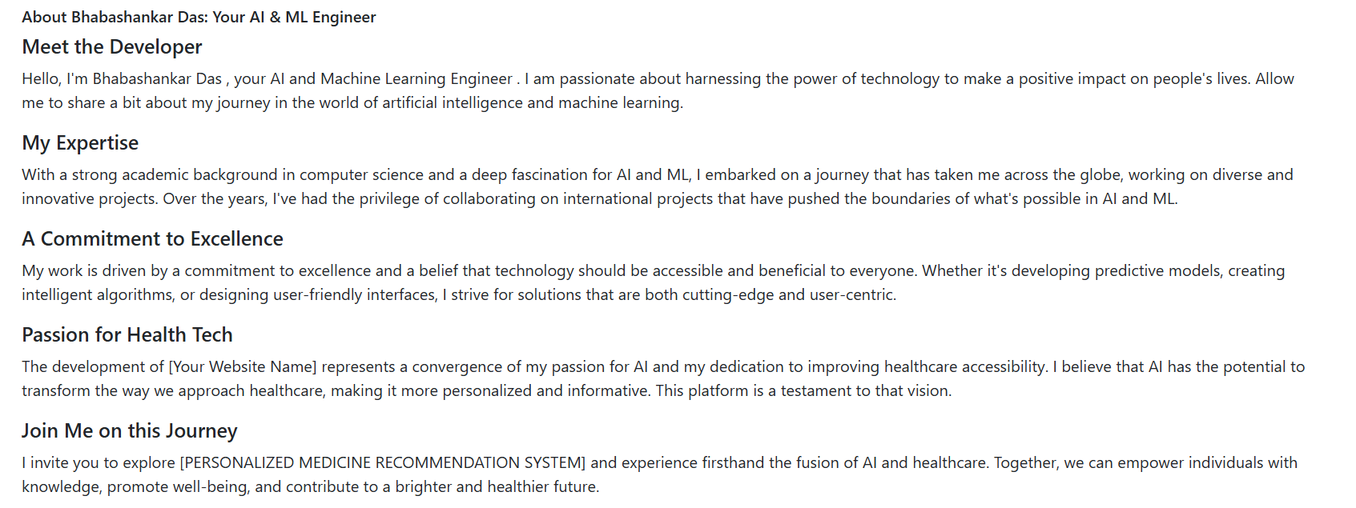
Workouts

Slide 16
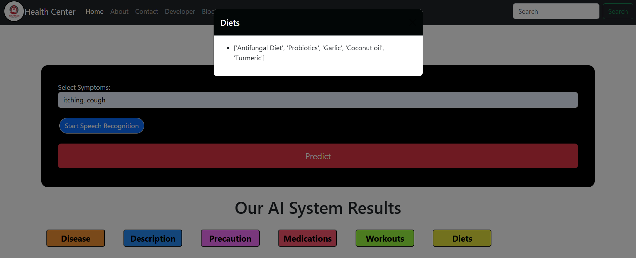
Diet

Slide 17
CONCLUSION
The system is a powerful tool for personalized healthcare. It combines cutting-edge technologies. Continuous improvement through AI is planned. It offers a vision of accessible and intelligent healthcare solutions.

Slide 18
FUTURE ENHANCEMENT
Multilingual Support
Advanced AI
Wearable Integration
The future holds exciting possibilities for enhancing the system's capabilities.

Slide 19
REFERENCES
Pereira, R. C., & Souza, J. R. (2020). Personalized Medicine: Current Challenges and Future Directions. Journal of https://doi.org/10.3390/jpm10030091 Personalized Medicine, 10(3), 91-105. This paper discusses the advancements and challenges in the field of personalized medicine, with a focus on how technological systems can assist in providing personalized healthcare recommendations.
2. Bai, Z., & Zhang, D. (2021). Machine Learning in Healthcare: Applications and Future Prospects. Health Information Science and Systems, 9(1), 1-10. https://doi.org/10.1186/s13755 021-00423-4 This article explores the application of machine learning techniques in healthcare, including symptom-based prediction systems and personalized medicine.
3. Tredan, O., & Boulay, L. (2019). Natural Language Processing in Healthcare: An Overview. Journal of Medical Systems, 43(2), 45-56. https://doi.org/10.1007/s10916-019- 1347-2

Slide 20
Q&A
Thank you all for your attention! Any questions?

